Slide 1

Python
Best practices

Slide 2
Project architecture
and best practices

Slide 3

Repository

Slide 4




/
README.md
assets
screenshots
screenshot_page_1.jpg
src
main.py
env
operations
substraction.py
addition.py

Slide 5
/
README.md
main.py
operations
substraction.py
addition.py
assets
success.gif
env

Slide 6
Best practices

Slide 7
Clean code.

Slide 8
Transparent namming
strp_upc_str_list(x)

Slide 9
Transparent namming
list_to_string_to_uppercase_and_strip(first_name)

Slide 10
Transparent comments
Why > What

Slide 11
Transparent comments
# Put a list to string, put each letter to upper case and strip the text
list_to_string_to_uppercase_and_strip(first_name)
# Format the user’s first name to avoid formatting issues in the database
list_to_string_to_uppercase_and_strip(first_name)

Slide 12
__init__.py ?

Slide 13
/
README.md
main.py
operations
__init__.py
substraction.py
addition.py
assets
success.gif

Slide 14
What is printed?
''Hey, did you know {0} was {1} at {2} but from {3} he is a {4}?''.format(user, precedent_job, precedent_compamy, actual_time, new_job)

Slide 15
What is printed?
f ''Hey, did you know {user} was {precedent_job} at {precedent_compamy} but from {actual_time} he is a {new_job}?''

Slide 16
Docstring
Formated & typed
explanation

Slide 17
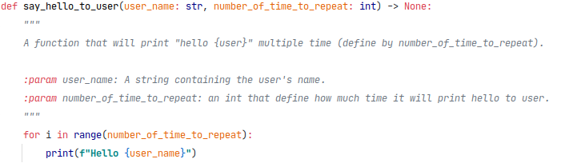

Slide 18
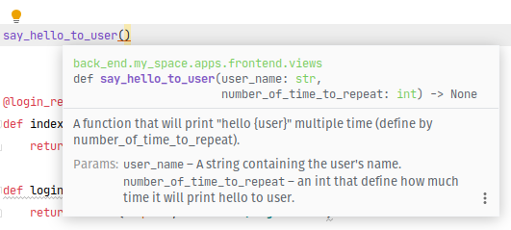

Slide 19
How to import ?

Slide 20
import utils
utils.print_hello()

Slide 21
from utils import calculate, add, Calculator
from utils.file import function
add(1, 2)

Slide 22
The end

